Slide 1
End-to-End IPSec Encryption
Aviatrix High-Performance Encryption (HPE)

Slide 2
NIST Tenet
From NIST Publication 800-207 - Zero Trust Architecture (ZTA)
“All communication is secured regardless of network location. Network location alone does not imply trust. All communication should be done in the most secure manner available.”

Slide 3
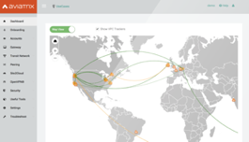
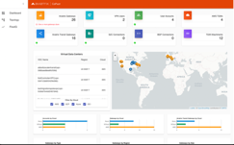
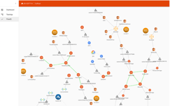
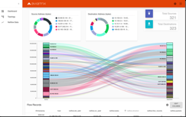









The network built by Aviatrix is always Encrypted – No Other Option
7
Aviatrix
CoPilot
Aviatrix
Controller
Single Multi-Cloud
Provider
VPC
VPC
VPC
VPC
VNet
VNet
VPC
VPC
VCN
VCN
Region 1
3
Region 2
INTERNET
Private Interconnect

Slide 4
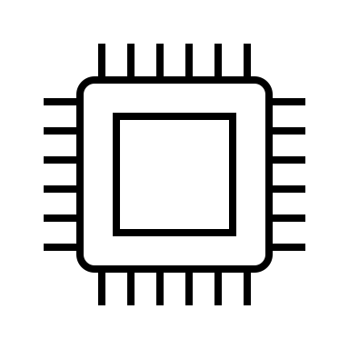

Standard Network Encryption Throughput
Native Cloud IPsec VPN solutions have a maximum encryption performance of 1.25Gbps per tunnel
That’s because virtual routers utilize a single core, and they establish only one tunnel
VPN, Direct Connect, ExpressRoute
AWS TGW, Azure vWAN
~1.25 Gbps
Encrypt/Decrypt
Encrypt/Decrypt
IPSec
Impacts Applications Performance and Increases Business Risk

Slide 5

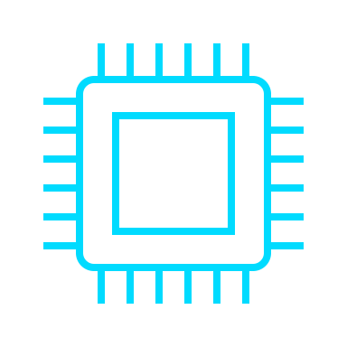
Aviatrix Secure Cloud Networking | High-Performance IPsec Encryption
Aviatrix Controller automatically builds multiple tunnels between Aviatrix devices
Uses all available CPU cores
IPsec encryption performance can be up to 90 Gbps
Aviatrix
Transit or
Spoke GW
Aviatrix
Transit or
Spoke GW
Encrypt/Decrypt
High-Performance
IPSec
Encrypt/Decrypt
Aviatrix
Secure
Edge GW
Up to
100 Gbps
Aviatrix
Transit GW
Aviatrix

Slide 6
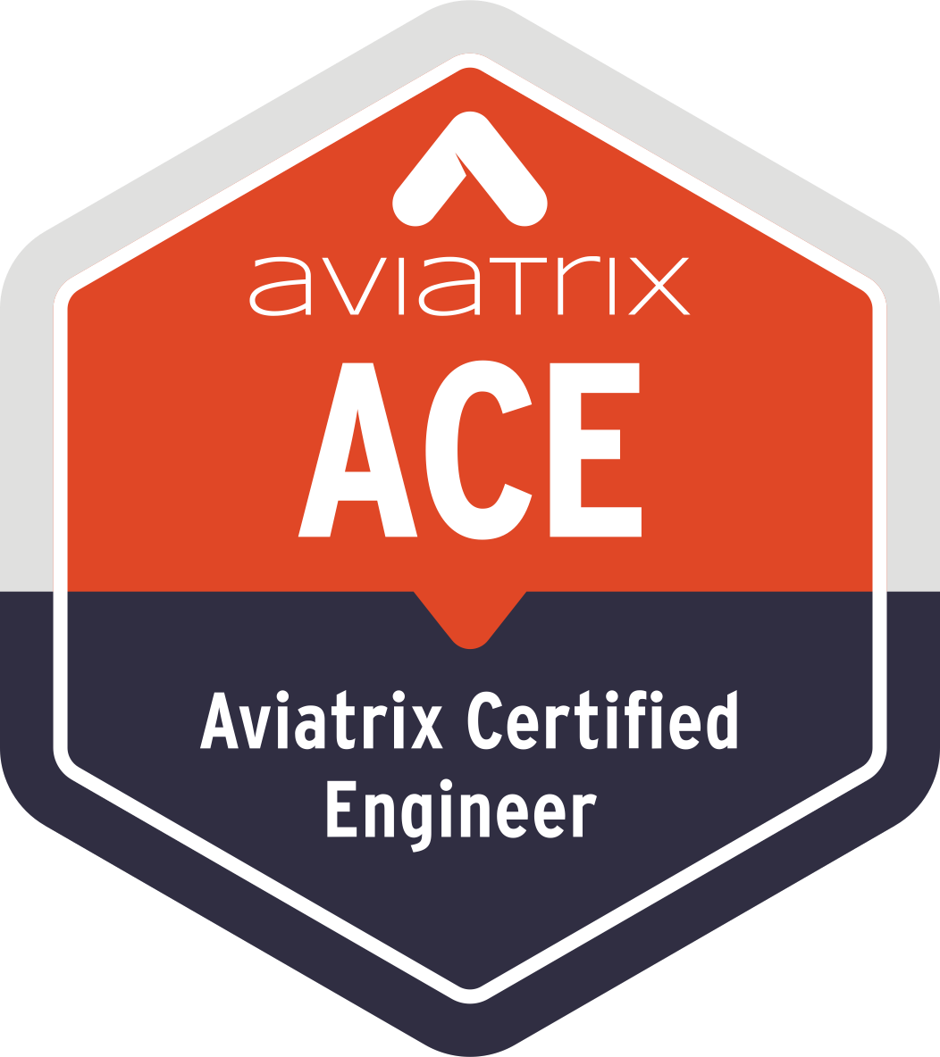

Aviatrix Certified Engineer (ACE)
COMMUNITY
https://aviatrix.com/ACE
https://community.aviatrix.com

Slide 7
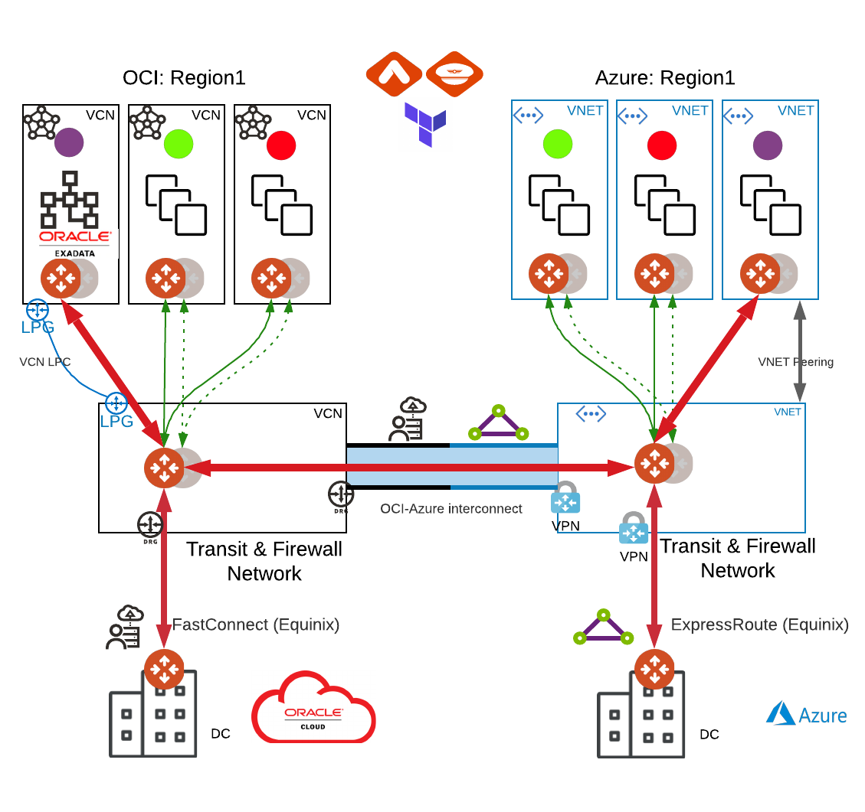
HPE – Public or Private IP
HPE in the same cloud
Will use CSP-native peering so the tunnels will be built over private IPs.
HPE across different clouds
Supported over private circuits (Direct Connect, Express Route, Cloud Interconnect, Fast Connect).
Supported over internet (AWS, Azure, GCP, OCI).
HPE over the public internet

Slide 8




Zero-Trust = Trust No One [Including Apps (TLS)]
Zero-Trust = Trust no one, including
Applications even with TLS
Private circuits provided by CSP
Peering/Attachment provided by CSPs for VPC, VNET, K8S, Serverless, etc.
MACSec encryption is NOT end-to-end encryption.
Only layer 2 and hop-by-hop
IPSec is the standard protocol for end-to-end encryption
The data plane must be IPSec encrypted
Aviatrix Datapath Encryption
Public
Cloud
UNTRUSTED
Datapath Encryption = Maybe
Application Encryption = Maybe
Azure Express Route
Aviatrix Datapath Encryption
UNTRUSTED
AWS Direct Connect
Data Center
OR Colocation
TRUSTED LAN
8
https://aviatrix.com/blog/secure-your-connection-to-the-cloud-macsec-vs-ipsec/

Slide 9
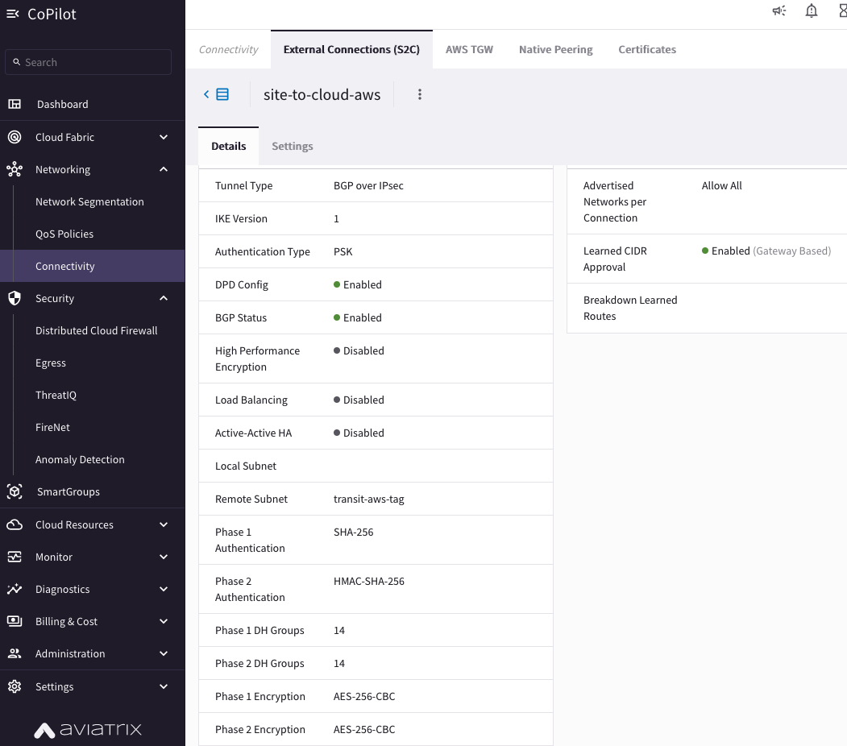
Check Encryption and BGP Route Approval
Move this slide in the demo slide

